Slide 1
Packages, Includes and Macros

Slide 2
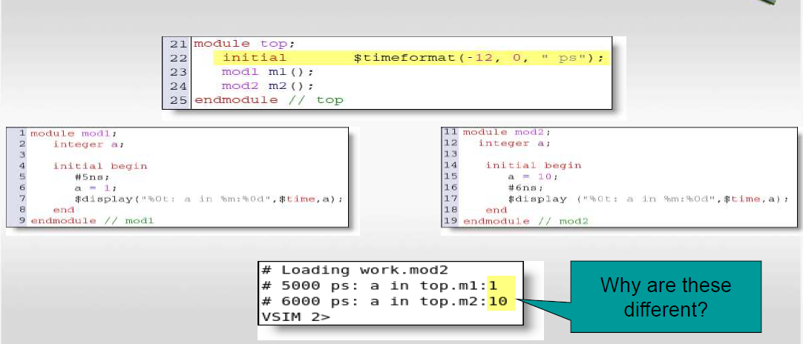
Namespaces
Notes:
Consider a situation with two modules named mod1 and mod2.
mod1 waits for 5ns and then sets the variable a to 1 and then displays it.
In mod2, it sets a to 10 at time 0, then it waits 6ns and then displays the value of a.
When this is run, it can be seen that at 5ns, the a in mod1 that has been instantiated as m1 is 1 and mod2 that is m2 is 10.
The fact that a is changed in mod1 after it was changed in mod2 makes no difference because these 2 modules have their own namespace. This means that they don’t see each other and there is no interference between a in mod2 and a in mod1 even though they have the same name, they have different namespaces (considering the entire path to them from top)

Slide 3
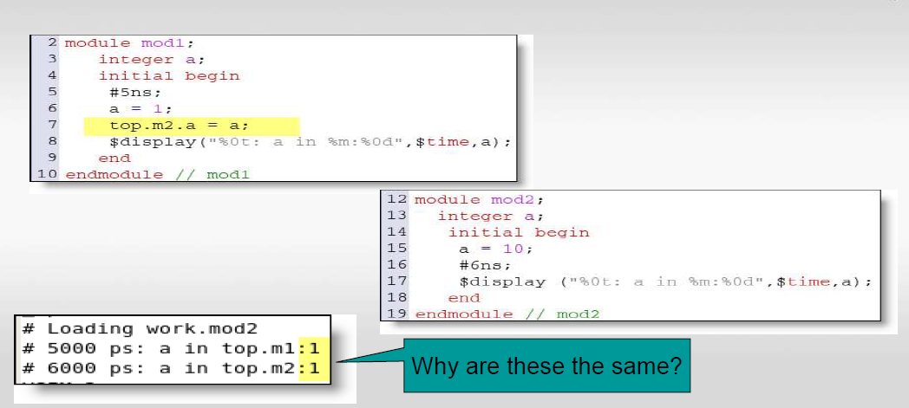
Sharing Variables Across Namespaces
Notes:
Instead, with this approach, with mod1 waiting 5ns, then set a=1 and then set a inside mod2 equal to its copy of a.
The code in mod2 is the same as the previous example.
On running the code, the value of a will be the same since mod2 set a=10 and mod1 waited for 5ns and set its a to 1 and then it set mod2 version of a to 1 as well.

Slide 4
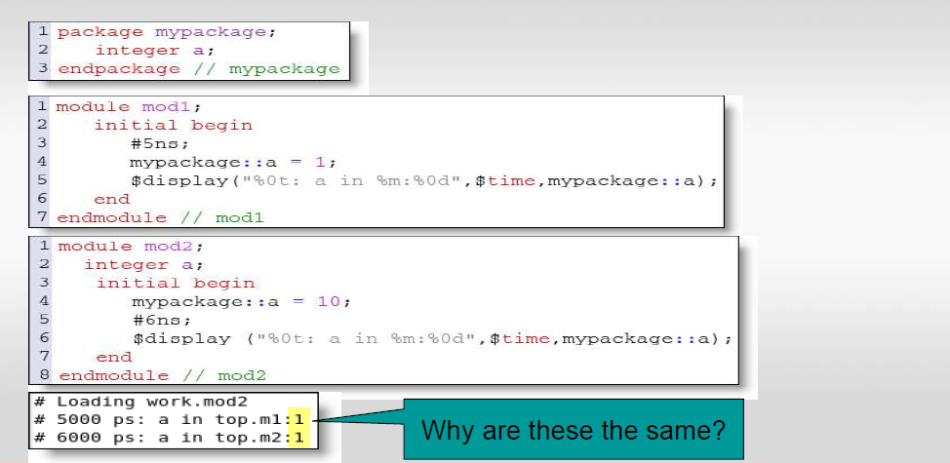
Packages: A Common Namespace
Notes:
A package is a way to organize and encapsulate related declarations, datatypes, and functions.
Packages are a SV compilation unit. So are modules, interfaces, and programs compilation units. A compilation unit is the smallest entity that can be compiled independently or separately from the other parts of the design.
Within the package mypackage, a variable a is declared.
In mod1, after waiting for 5ns, referring to a within the package, it is set to 1.
In mod2, there is a local integer a. The package mypackage’s a is set to 10. After waiting for 6ns, the value of a in mypackage is displayed.
On running the code, the value of a is the same since both modules are referencing the same variable declared in the package. Mod2 sets variable a=10 at time 0 that gets overwritten in mod1.

Slide 5
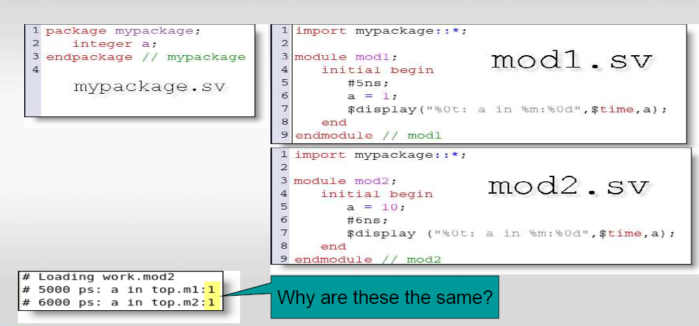
Import Packages to Access Namespace
Notes:
This example has integer a in mypackage and the package is imported into mod1 as well as mod2. On running the code, the same value is obtained for a. The value of a is set to 1 in mod1 and 10 in mod2. a is not declared in any of these modules. Instead a is declared in the package. This is where the concept of namespace comes into picture. Package is a namespace and when it is imported, we make its namespace available to the module in which it is imported, even if we dont explicitly refer to it.
Since both modules share the same namespace, they were talking about the same copy of a. Because of this, mod1 has overwritten mod2.

Slide 6
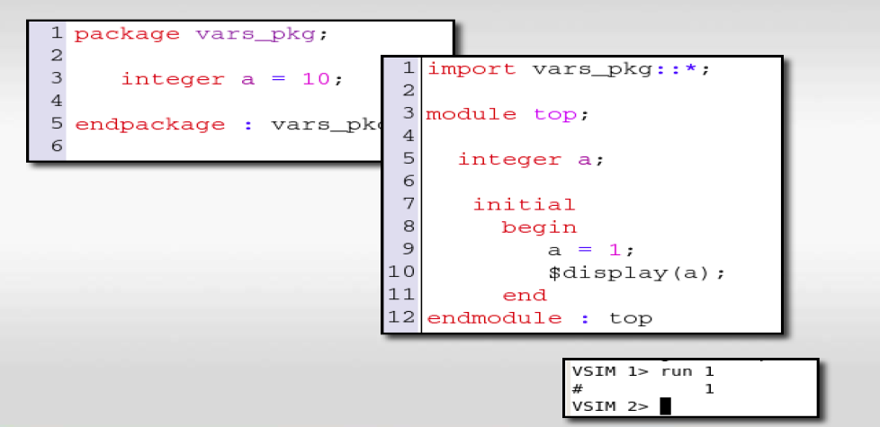
Declaration Overrides
Notes:
Another way of using the package is by declaring the integer a and setting it to 10 in the package. The package is imported for module top. This gives the module a=10. Another integer is declared within the module that is set to 1 and value of it is displayed. This a overrode the value of a which was in the package. This means that if you have a variable of the same name in the package and in the module, then the value of the variable in the package gets overridden by the one in the module. Whenever a variable is locally declared, it overrides the variable of the higher scope.

Slide 7
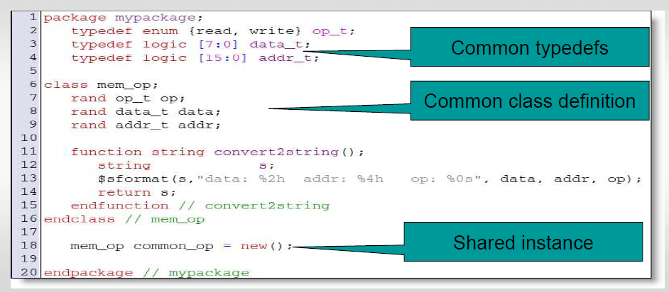
Packages and Classes
Notes:
Let’s look at the use of package in terms of classes.
In this example, the mem_op class has an operand that’s either read or write, there’s data that’s 8-bit and there’s a 16-bit address word.
There’s a convert2string function within this class. This is going to print out the value of the variables declared within the class.
A variable of type mem_op called common_op is declared. The new() function is used. So, there’s an actual object stored in this package and whoever imports this package has access to this shared instance.

Slide 8
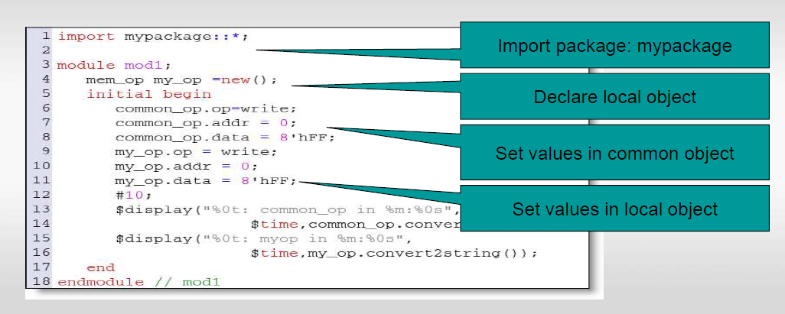
Accessing common and local objects
Notes:
This is an example that shows accessing local and common objects with different modules in the shared package.
For the common_op from mypackage which is used in mod1, this mod1 creates a local variable called my_op. It then sets common_op to some values, and sets my_op to some values. It waits 10ns and then displays common_op and my_op using the convert2string method.

Slide 9
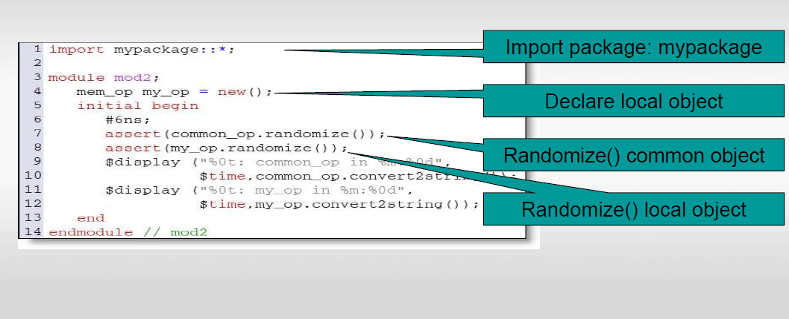
Randomizing common and local objects
Notes:
mod2 also imports the mypackage, also creates my_op, waits 6ns, randomizes the common_op, randomizes my_op and prints them out.

Slide 10
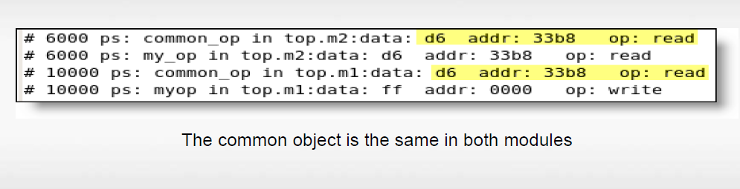
Package and Class Example
Notes:
On running the code, we see the common_op and regardless of the order, both of them are identical because they both import the package and share it. Whereas the local copy of my_op is different in each one of them.

Slide 11
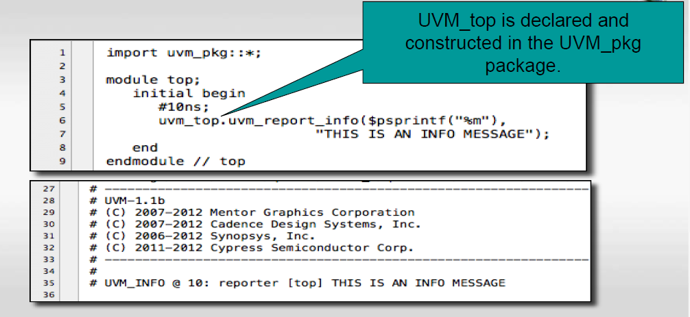
UVM is delivered as a package
Notes:
UVM itself is declared as a package, so when you create a package, that uses UVM, it imports the uvm_pkg and it has all the class declarations (hundreds of them). It has a common variable that everyone can use called uvm_top.
This example shows the use of uvm_top to call the reporting function. The uvm_top is declared and instantiated inside uvm_pkg.

Slide 12
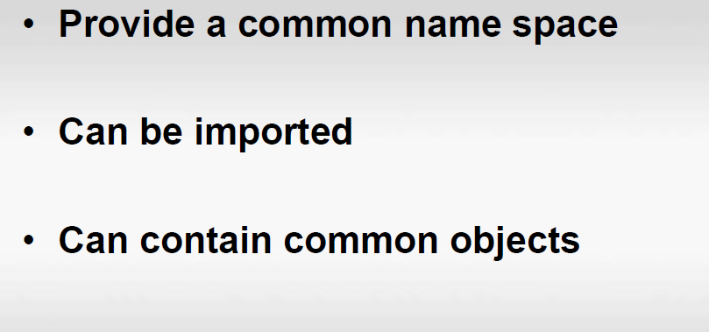
Packages
Notes:
In a nutshell, packages provide a common name space, they can be imported and they can contain common objects as well as common definitions.
Any module that imports the package will import the definitions associated with that package.

Slide 13
MACROS

Slide 14
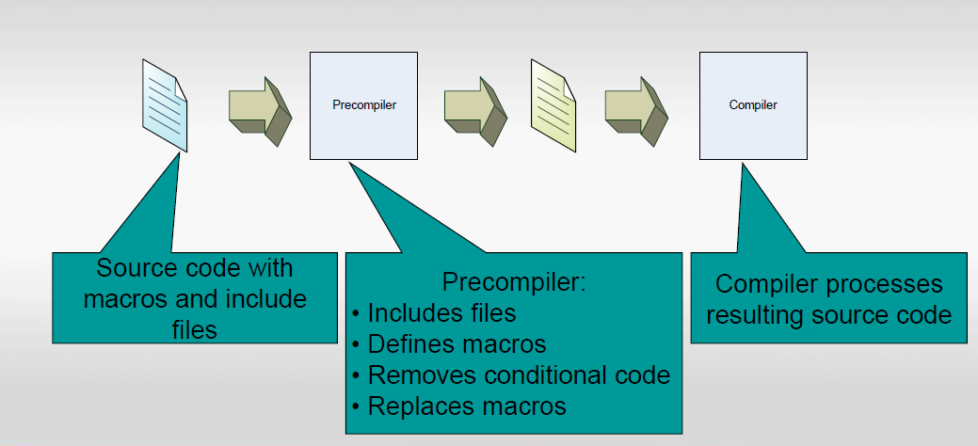
SystemVerilog Pre-Compiler
Notes:
SV, like C, has a precompiler, some source code that has macros and source code etc in it.
The precompiler includes files, processes macros, creates a bit of code that’s ready to be compiled. That code goes into the compiler. Just like C, there’s macros and include files that get managed by the precompiler.

Slide 15
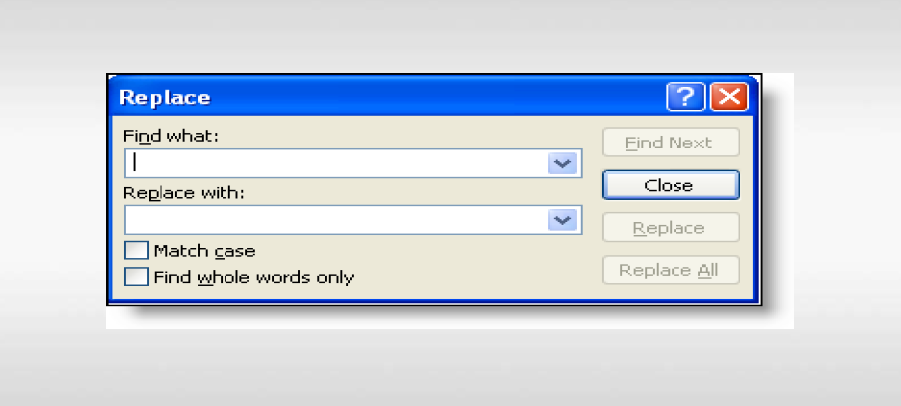
Macros deliver ‘find and replace’ functions
Notes:
Macros generally do a textual replacement, similar to doing a find and replace. You take the macro name and you replace it everywhere with the text that’s the definition of the macro.

Slide 16
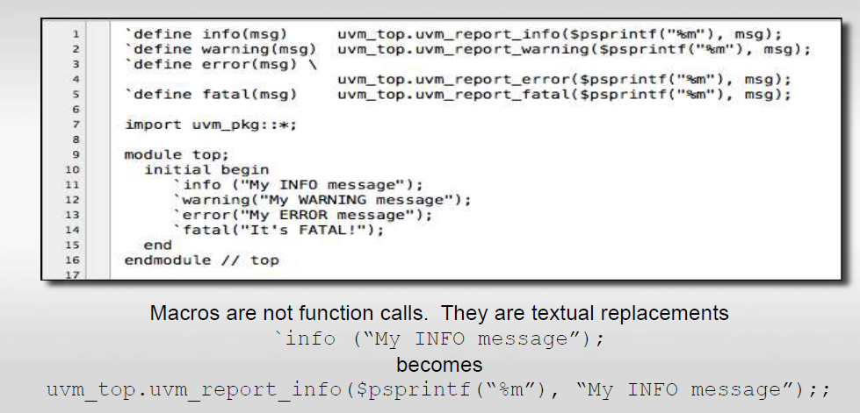
Macro Example
Notes:
This example shows defining a macro.
In the first line, info gets replaced with uvm_top.uvm_report_info... %m is the module that you’re in.
Similarly, second line warning gets replaced with uvm_top.uvm_report_warning..Similarly, with error and fatal.
Now, in the module, instead of typing all the detailed code, we can use `info, `warning, `error and `fatal. The precompiler will take the `info and replace it with the code as shown. This is not a function call, instead it’s a macro replacement.

Slide 17
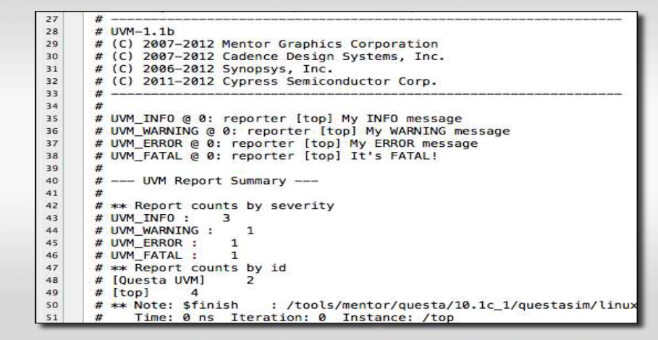
Running Report Macros
Notes:
When the example code is run, we see all the messages for info, warning, error and fatal.

Slide 18
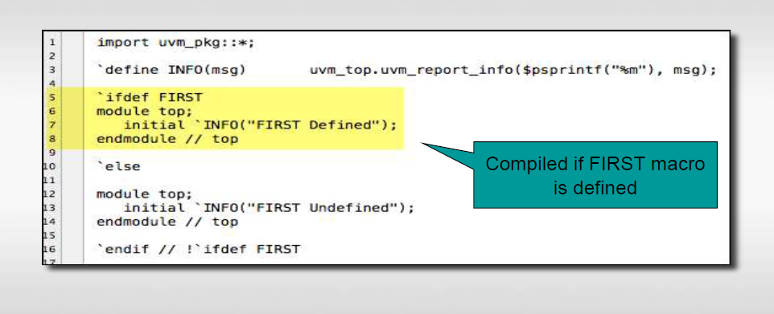
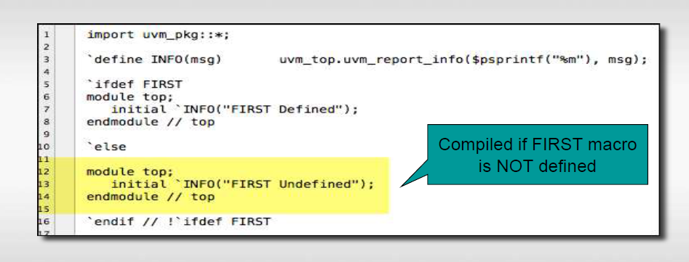
Conditional Compilation
Notes:
Macros also allow to do conditional compiles. `ifdef FIRST means if the macro FIRST is defined, then compile the module top code that prints out the infor FIRST defined. The INFO macro has been defined above. Macro names are case sensitive so INFO is different from info.
`else means if FIRST is not defined, then the next module is compiled that prints the info FIRST Undefined.
In case FIRST is not defined, the `else part of code is compiled and the other code just disappears. The precompiler throws it away and it never gets seen, compiled or analysed.

Slide 19
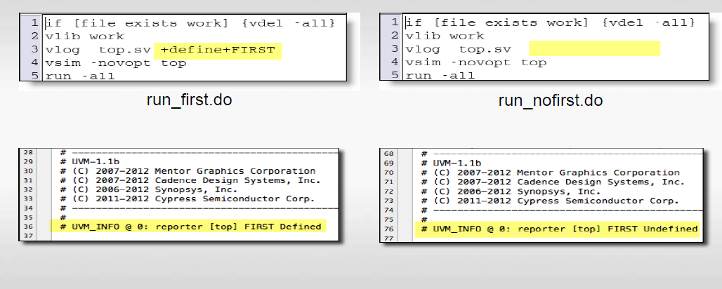
Define macro when you compile
Notes:
When the code is run, we can compile with vlog +define+FIRST that defines the FIRST macro, and on running, we see FIRST defined getting displayed.
If the FIRST is not defined, then on running, we see FIRST Undefined getting displayed. On compilation, the code that’s not running has disappeared and is never seen.

Slide 20
INCLUDES
Notes:
Next, let’s look into the include files that’s also used to organise code like packages and macros.

Slide 21
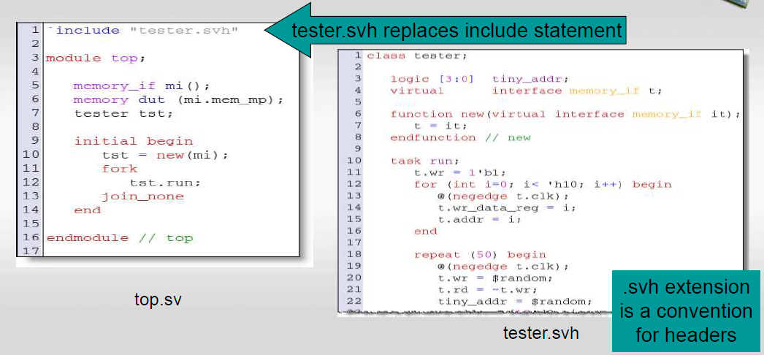
Include same as paste
Notes:
The include statement in the first line takes the file that’s placed within the double quotes and places it in the source code. So, the preprocessor reads this file tester.svh and sticks it in top.sv file as if it’s always there (pastes the file into the file with the include statement) and then the file gets compiled.
A file with the .svh extension is often referred to as a SystemVerilog include file or header file. It contains macro definitions, parameterized classes, and other code snippets that are meant to be included in other SystemVerilog files.

Slide 22
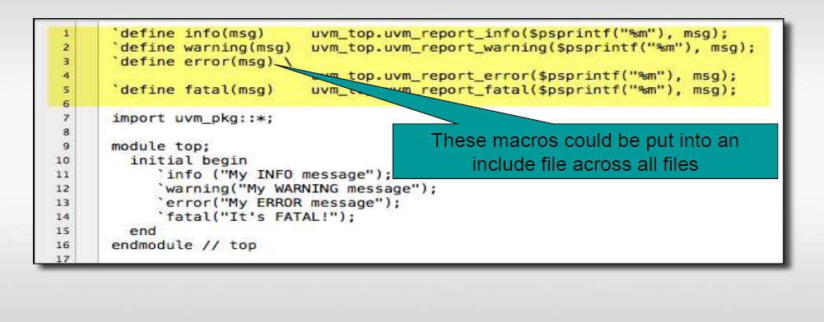
Replace Common Code
Notes:
In include files, you can take common code, for example the macros for info, warning, error and fatal, that let’s us print messages. You can put these in an include file and include them whereever needed, and you’ll have access to these macros.
This is how UVM works as well. The UVM has macros called uvm_info, uvm_warning, uvm_error, uvm_fatal. It has a file called uvm_macros.svh. Usually when you use UVM, you include this file along with the package uvm_pkg to use UVM in totality.

Slide 23
Sharing Declarations
Notes:
When creating a testbench, sharing declarations is done using packages and includes.

Slide 24
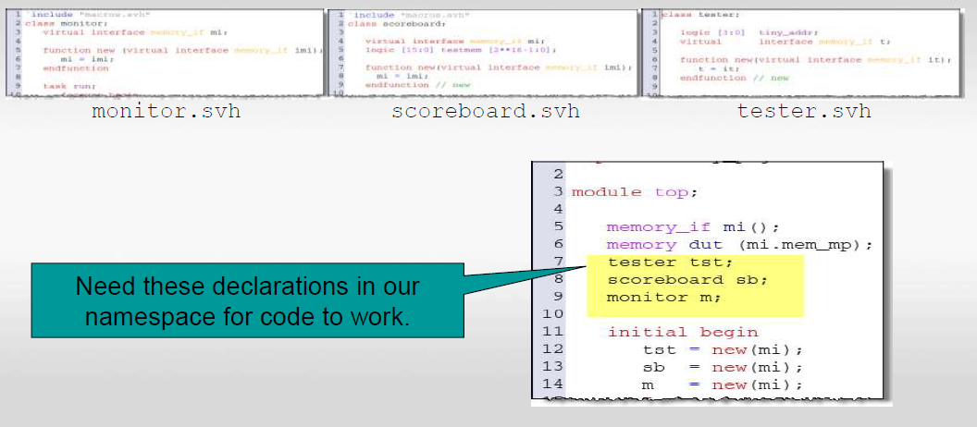
How do I get my declarations into many files?
Notes:
Consider the situation with a testbench with a module, an interface, and a memory DUT, and 3 objects – a tester, SB and a monitor. The codes of these have been shown that define these types. We want to get these definitions into the module so that we can use these object types.

Slide 25
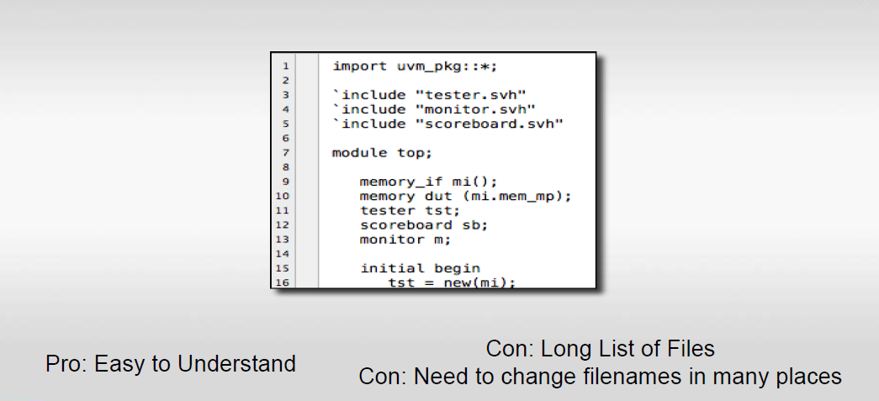
One Solution: Include Files
Notes:
One Solution to get the declarations into the file is to include the file names. This way is easier to understand.
The downside of this is that you could have a very long list of files and you’d have to change them on all your source code because you’ll be including files in all your source code. Also, if you’re not careful, you can get redefinition of the same class in different places. This will probably not work out very well.

Slide 26
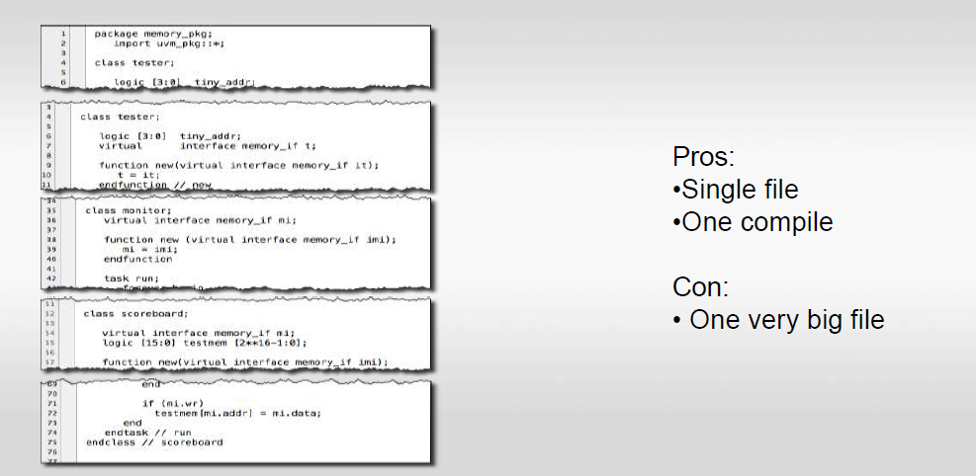
Another solution: Packages
Notes:
Another way around this is to make a big package called a memory_pkg, put those class definitions in that package.
The problem in this is that you get a gigantic package file. And there may be hundreds of class definitions in a given testbench. When people use source control and checks out the giant package file to work on one of the classes, while everybody else is locked out of it, which is a problem. So, you wouldn’t want a very big file as it would make it difficult for teams to work together.

Slide 27
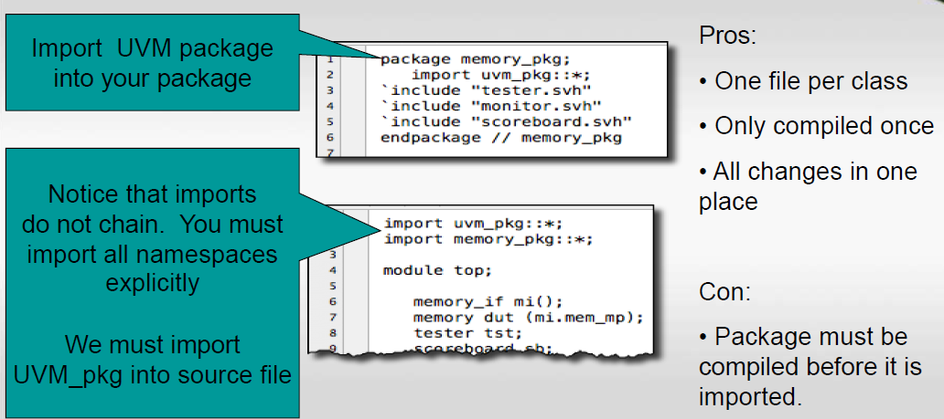
Suggested Solution: Combine Includes and Packages
Notes:
The best solution is to combine the two. So, memory_pkg will import the uvm_pkg, so we can access it. Then, we include the tester, monitor and SB files in the package definition.
Then we import the uvm_pkg and the memory_pkg, with which we can access all the definitions with the package without having those include files everywhere. With include files in the package, different people within a team can work on the different files without interfering with each other and there will be no need to merge the updated work as they would be working on different files.
So, the recommendation is to create a package and include one file per class, usually with the same name as the class as it makes it easier to work on the testbench. Then the package is imported into the testbench

Slide 28
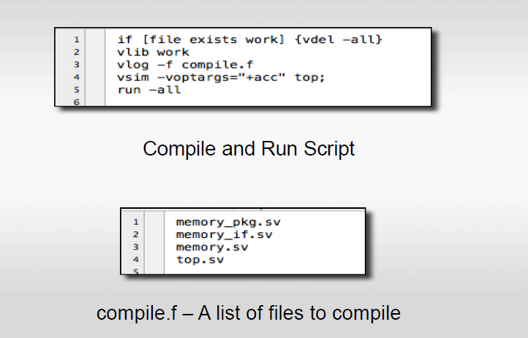
Compiling
Notes:
We then compile our testbench by using a compile.f file that contains a list of files that we’re compiling. So vlog –f is called with a list of files. Note that memory_pkg needs to be compiled first because its getting imported in the other files. So, whenever you use a package, you have to compile it before you use it.

Slide 29
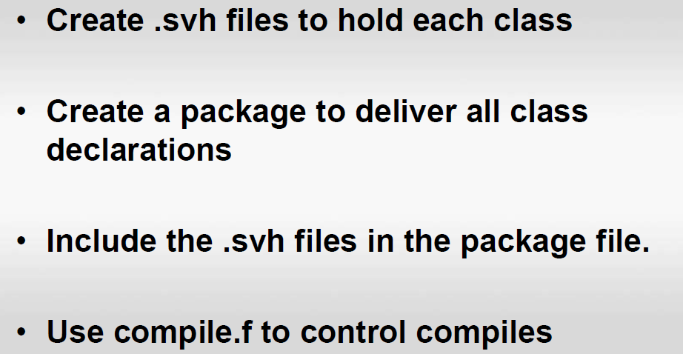
Summary
Notes:
We create .svh files for each class. .
We create a package to deliver all class definitions to the testbench.
The .svh file is included in the package file, so that we can have one package with many files that is easier to share.
The compile.f file controls the order of compilation.

